Slide 1
What is BPT?
BPT is the abbreviation for Business Process Testing
BPT is a role-based methodology that enables Subject Matter Experts to create business process tests using reusable business components
BPT utilizes HP/Mercury Quality Center (QC) with BPT module and QuickTest Pro (QTP)
QC – Test Management Application
QTP – Test Automation Tool

Slide 2
What is BPT?
BPT is the abbreviation for Business Process Testing
BPT is a role-based methodology that enables Subject Matter Experts to create business process tests using reusable business components
BPT utilizes HP/Mercury Quality Center (QC) with BPT module and QuickTest Pro (QTP)
QC – Test Management Application
QTP – Test Automation Tool

Slide 3
Test Automation Architecture
HP Quality Center (QC)
Resources:
Functions
Object Rep.
Environment
Test
Test
Test
Test
Test
Component
Component
Component
Business Process Testing (BPT)
HP QuickTest Pro (QTP)
Application Under Test

Slide 4
SME-Centric Test Automation Process using Mercury BPT
A partnership between subject matter experts (SME) and test automation developers.
Allows SMEs to automate and execute their own automated tests.
Fast component development (2-4 Pages/Windows per day)
Fast test case development (4+ test cases per day)
Creating of Automated test cases is similar to manual test case development.

Slide 5
Test Automation Process
Automation Architecture Design
Automation
Engineer
Create Function Libraries
Create Object Repositories
Create Business Components
Drag Components to create tests in QC
Configure Input/Output parameters
Subject Matter Expert
or
Test Engineer
Debug tests in QC Test Plan module
Add tests to test set in Test Lab module

Slide 6
SME-Centric Process advantages
Responsibilities are clearly defined:
Automation developers define architecture and create components
Subject matter experts create automated test cases
SME doesn’t need to know/use QTP.
Uses very flexible Keyword/Data-Driven approach.
Reduced learning curve due to same approach across different applications/technologies
Applicable to all areas of automated testing, like regression, smoke, acceptance, etc.
Designed for Maintainability

Slide 7
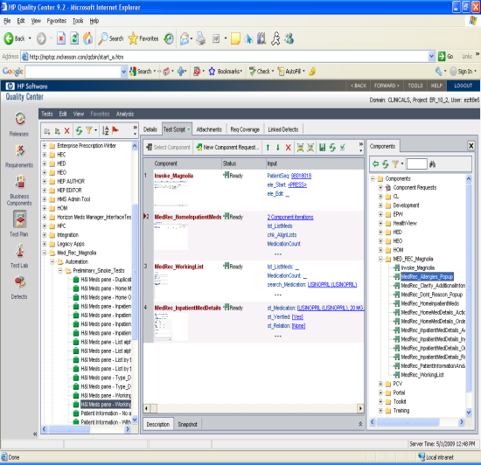
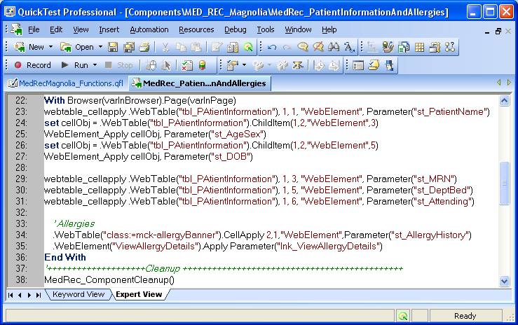
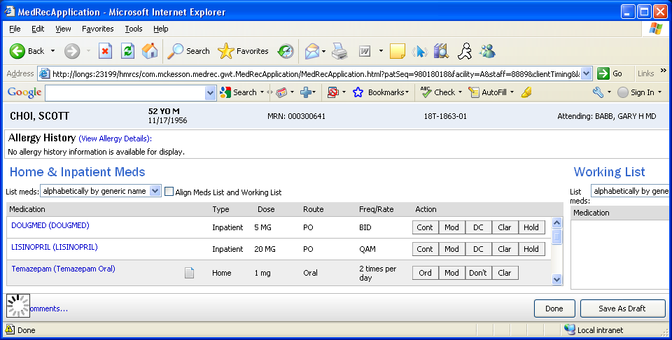
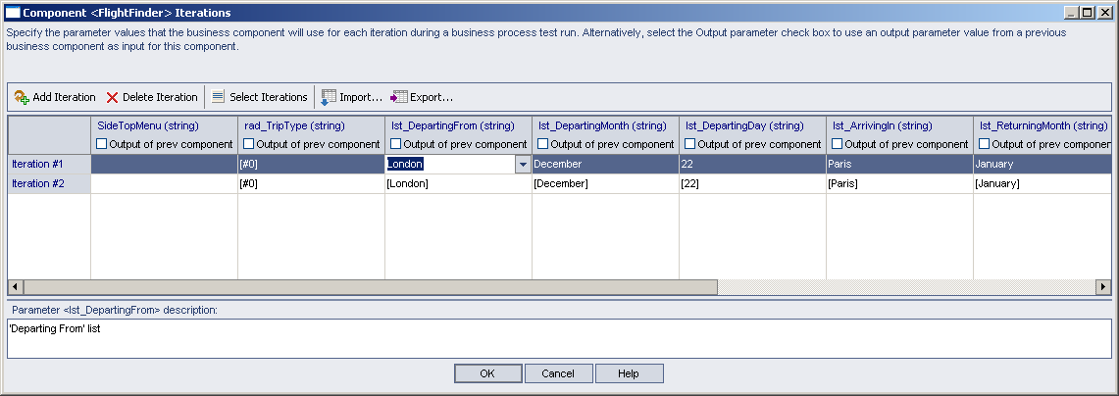
Automated Testing Process
Quality Center
QTP
AUT
BPT Components,
Automation Resources
AUT Testing
Test case
Results
Data

Slide 8
Test Automation elements
IDE: Quality Center with BPT/Mercury QuickTest Professional (QTP)
Environment Files
Application Areas
Function Libraries
Object Repositories
Business Components and Test Scripts

Slide 9
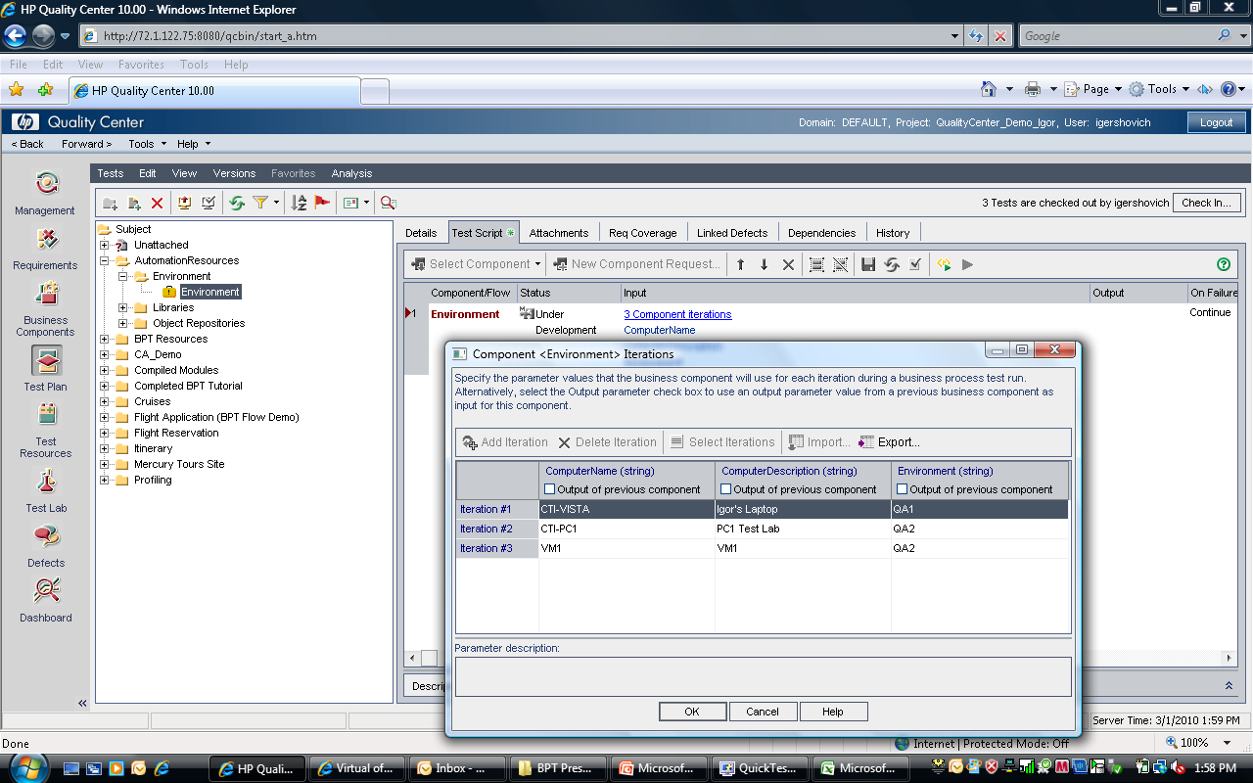
Environment (BPT test) for Computer name – Test Environment Mapping
Computer name – Test Environment mapping

Slide 10
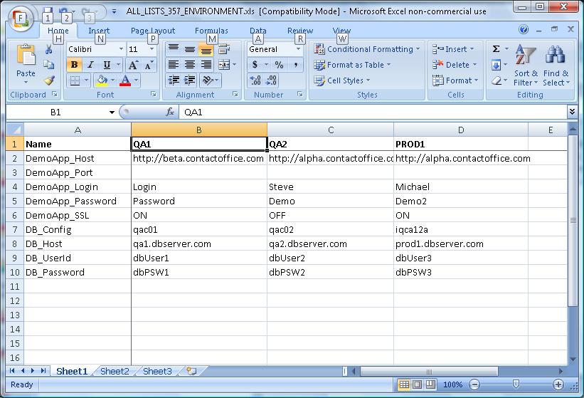
Environment.xls

Slide 11
Function Libraries
Technology libraries
Web
GWT
.Net
Win32
Common libraries
Utility
DB
CommProtocols
Project Specific libraries

Slide 12
Business Components
Component is a reusable module to perform tasks on logically independent application parts (Page or Window).
Components use Input/Output parameters for data input/verification and navigation within Page or Window.
Input/Output parameters also are used to pass data between components.
Components can use iterations.

Slide 13
Login component steps (example for Web Application)
Component initialization
Load environment variables like URL, login credentials, DB connection strings, etc.
Close all browsers except QC
Invoke an application
Login
Verification that login is successful

Slide 14
Functional component steps (example for Web Application)
Component initialization – ComponentInit() function
Load environment variables like URL, login credentials, DB connection strings from Environment.xls file using QC OTA
Verify that Expected page is displayed
Side or Top menu navigation
Web Page internal flow

Slide 15
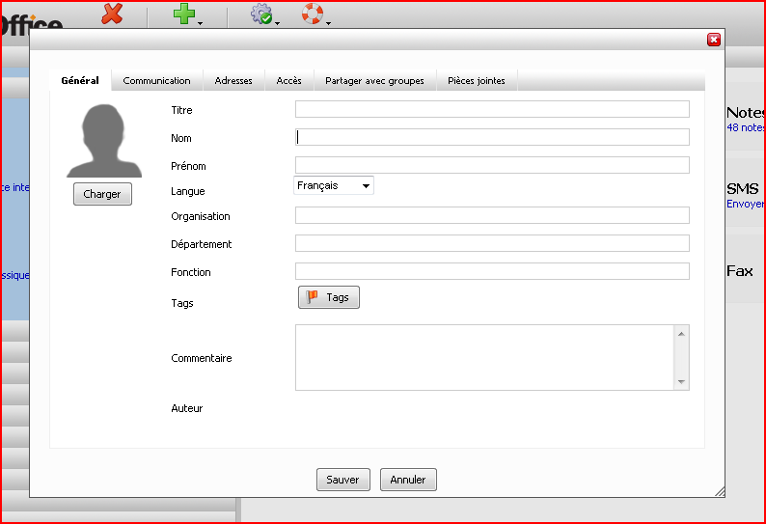
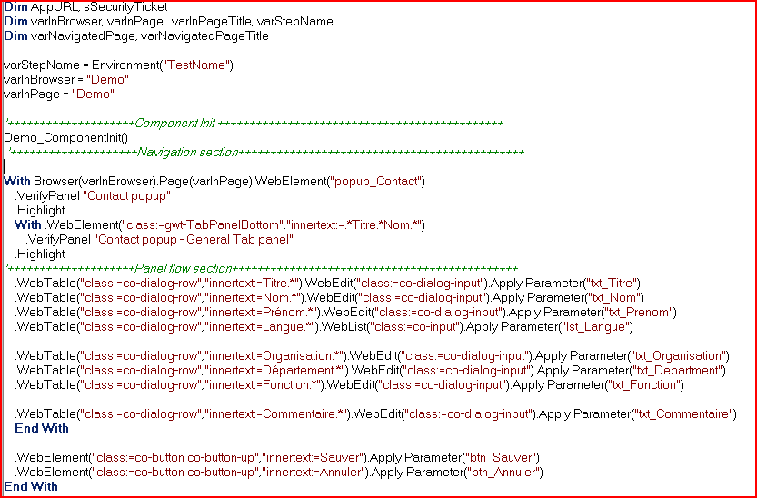
BPT Component script and AUT
AUT
QTP

Slide 16
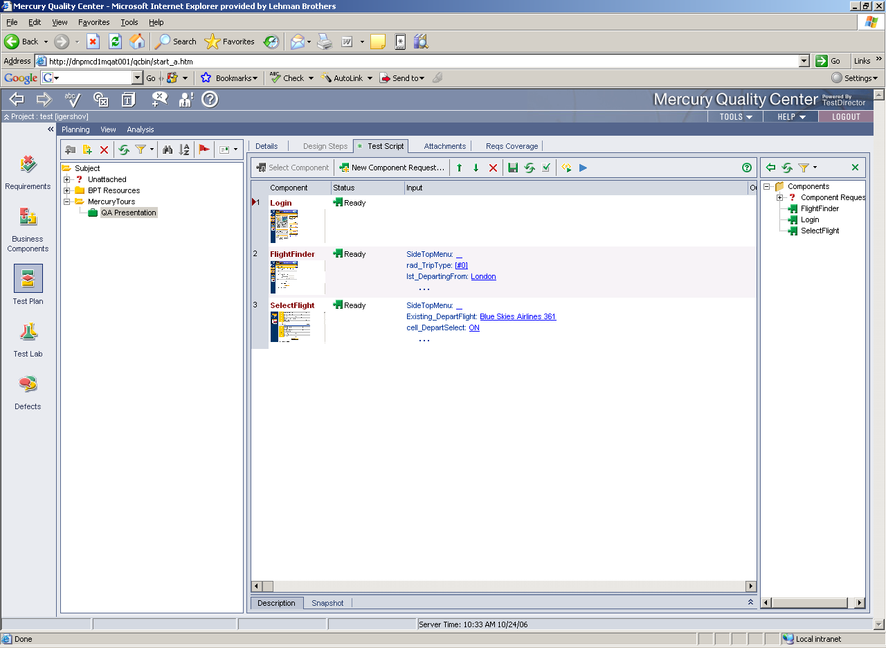
BPT Test case in QC
Data

Slide 17
Parameter Naming Conventions
Prefix | Object | Example
lst | List | lst_User
txt | Edit | txt_User
chk | Checkbox | chk_User
rad | Radiobutton/RadioGroup | rad_User
tab | Tab | tab_User
tbl | Table | tbl_User
cell | Cell in Table | cell_User
file | WebFile | file_User
ele | WebElement | ele_User
cmb | Combobox | cmb_User
st | Static Text (Read Only) | st_User

Slide 18
.Apply Method
Object.Apply Parameter(“Parameter_Name”)
.WebEdit(“Name”).Apply Parameter(“txt_Name”)
Apply method functionality:
Performs data substitution
Verifies if object exists and visible
Makes decision what to do with “Name” edit object based on Parameter data

Slide 19
Input Constraints for Edit (Text Box) object
Value | Action | Example
 | No action
<CLEAR> | Clear edit field | <CLEAR>
text | Enter text | Hello
[text] | Verify text | [Hello]
[<ENABLED>], [<DISABLED>] | Verify if object is Enabled/Disabled
[<EXIST>],[<NOEXIST>] | Verify if object exist/no-exist
[<REGEX>Pattern] | Verify that Pattern matches text | [<REGEX>TestCase.*]

Slide 20
Input Constraints for Lists (Drop Down Lists)
Value | Action | Example
 | No action
text | Select list item with matching text | Hello
[text] | Verify selected list item | [Hello]
[<ENABLED>], [<DISABLED>] | Verify if object is Enabled/Disabled
[<EXIST>],[<NOEXIST>] | Verify if object exist/no-exist
#X | Select item with X location (#0-first item) | #5
[<NO_ITEM>text] | Verify that no item exists in a list | [<NO_ITEM>abc]

Slide 21
Working with Objects in Grids
row=WebTable().GetRowIndex(Parameter(“search_”),clmn)
WebTable().CellApply row, clmn, objType, Parameter(“cell_”)
iRow = WebTable().GetRowIndex(Parameter(“search_Name”),2)
WebTable().CellApply iRow,3,“WebElement”,”Parameter(cell_Age”)
Parameter prefixed with the word “search_” indicates which row to work with.
Row can be selected by using row number: #n
the text contained in the specified Column
Pattern
Parameters for objects in table cells are prefixed by “cell_”

Slide 22
Select a row to work with
Value | Action | Example
Text | Searches for text in specified column and returns row number | Pangea Airlines 632
#1 | Select Row by Number | #1
<REGEX>Pattern | Searches for pattern in specified column and returns row number | <REGEX>Pangea Airline.*
<NO_ITEM>Text | Verifies that record doesn’t exist in specified column | <NO_ITEM>Aspen Airline

Slide 23
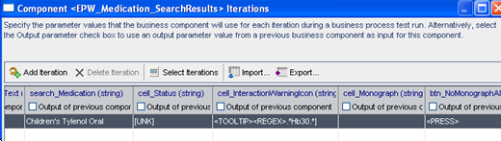
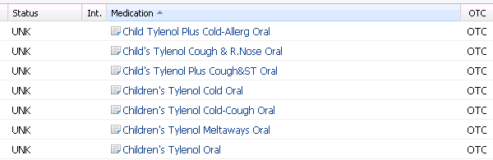
Example: working with grids

Slide 24
Data Substitution
Special tags for Dates, Times, SSNs, Unique values, DB Queries, Random, etc.
<SSN> - get substituted with unique SSN
<TODAY> - get substituted with today date (03/19/10)
<RNDDIG 3> get substituted with 3 random digits
<DateTime YYYYMMDDHHmmss>
<DB DBEnvironment::SQLStr>
Tags can be combined
[<REGEX><TODAY> at .* AM]

Slide 25

Questions?

